Slide 1

Jordan Lipson, Alfa Budiman, Wesley Howe, David Gayowsky
February 12th, 2023 for uOttaHack 5

Slide 2
Motivation
InnovaPost:
How do we optimize package deliveries for multiple addresses and trucks?
Expansion of traveling salesman: NP hard!
However… we can solve this!

Slide 3
Project Breakdown
Assumptions and Considerations:
Time taken to complete route:
Weather & traffic - use Google maps data!
Number of mail trucks:
How many do we have available?
Computational time:
Fine tune parameters to affect computational speed.

Slide 4
Project Breakdown
Four major components:
Recipient Identification
Recipient Allocation with K-Means Clustering
Delivery Sequencing with Metropolis Algorithm
Visualization

Slide 5
Technologies Used
Code writing and running:
Python, Jupyter Notebook
Route Data and Visualization:
Google Maps API, Folium
Optimization and Evaluation:
Numpy, SKLearn, Pandas

Slide 6
Recipient Identification
Delivery data - where are we going?
Addresses from file,
Google Maps API: retrieve address coordinates,
Then send to K-Means clustering.

Slide 7
K-Means Clustering
Groups physical locations of recipients based on proximity to each other,
Grouped into n clusters, number of delivery trucks,
Each clusters’ locations correspond to allocated recipients for a delivery truck.
Notes:
Each of k clusters → groups each point into cluster with nearest mean cluster center.
Assign each observation to the cluster with the nearest mean: that with the least squared Euclidean distance.^{[8]} Recalculate means (centroids) for observations assigned to each cluster.

Slide 8
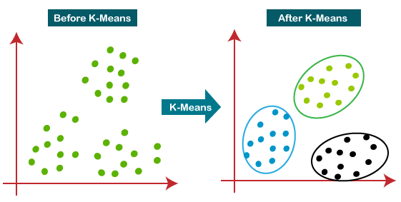
K-Means Clustering

Slide 9
K-Means Clustering
Initially choose n clusters or data points to be means (various initialization methods).
If data points chosen, assign each remaining data point to nearest one.
If not, proceed to update step, and re-calculate means for data points assigned to each cluster.
Repeat steps 2-3 until cluster assignments no longer change.
Notes:
Each of k clusters → groups each point into cluster with nearest mean cluster center.
Assign each observation to the cluster with the nearest mean: that with the least squared Euclidean distance.^{[8]} Recalculate means (centroids) for observations assigned to each cluster.

Slide 10
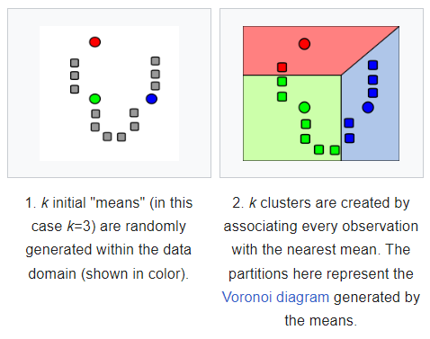
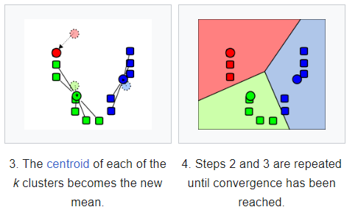
K-Means Clustering

Slide 11
Base Algorithm: Metropolis
Concept: Simulated annealing to solve “traveling salesman problem”.
Generate trial route,
Compute difference in route length,
Accept or reject trial route,
Vary temperature.

Slide 12
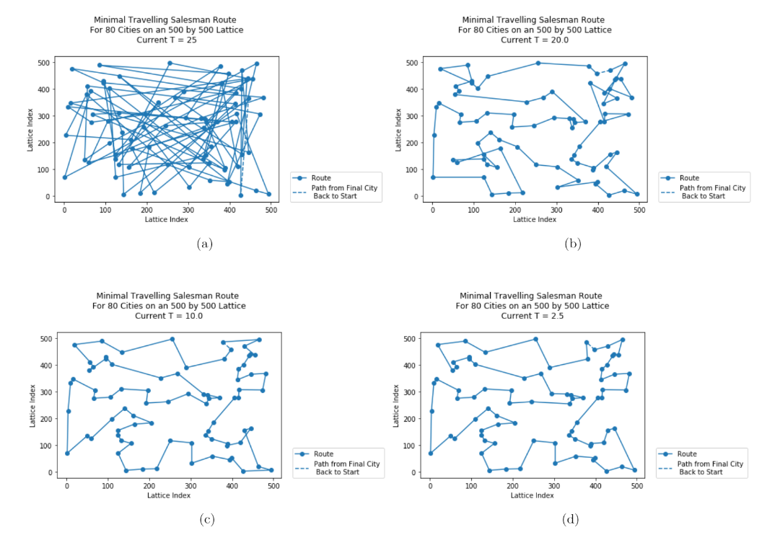
Base Algorithm: Metropolis
Example: Evolution to traverse 80 cities on 500 x 500 lattice, at:
(a) T = 25 (initial route),
(b) T = 20,
(c) T = 10, and
(d) T = 2.5 (final route).

Slide 13
Base Algorithm: Metropolis
In detail: magic math!
Generate trial route by swapping order of two randomly chosen destinations e.g.:
{n_{a}, n_{b}, n_{c}} → {n_{b}, n_{a}, n_{c}}
If new route is shorter: accept without condition,
If new route is longer: compute probability at current T:
P = e^{-Δd/T}
If P > randomly generated u ϵ U(0,1), accept.

Slide 14
Base Algorithm: Metropolis
Notes about Metropolis Implementation:
Metropolis algorithm is implemented once for each cluster or delivery truck.
Here, route length is not considered, route time is: still works with Metropolis algorithm!
To do this, consider Google Maps API data, or grab route times from Google Maps.

Slide 15
Visualization
Showing our routes on map:
Folium, interactive map.
Google Directions API to generate route for each list of waypoints.
Notes:
Application programming interfaces (APIs) are a way for one program to interact with another. API calls are the medium by which they interact. An API call, or API request, is a message sent to a server asking an API to provide a service or information. → request info from google maps.

Slide 16
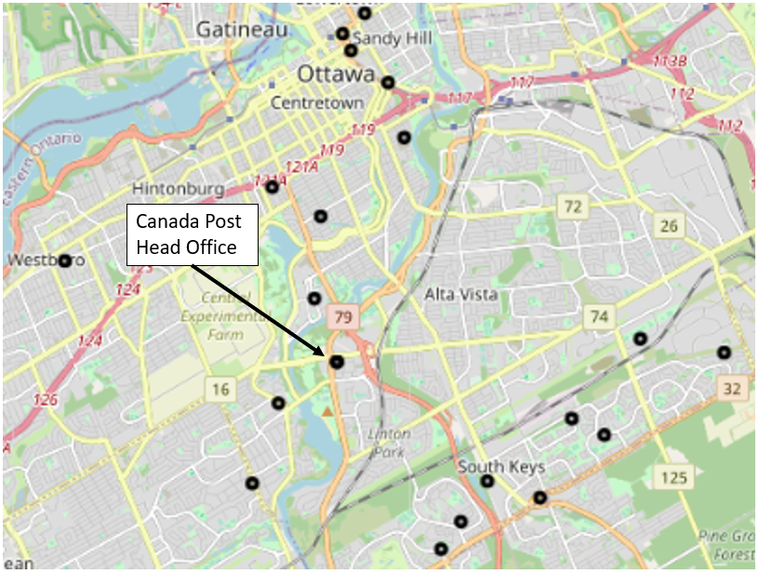
All Recipients

Slide 17
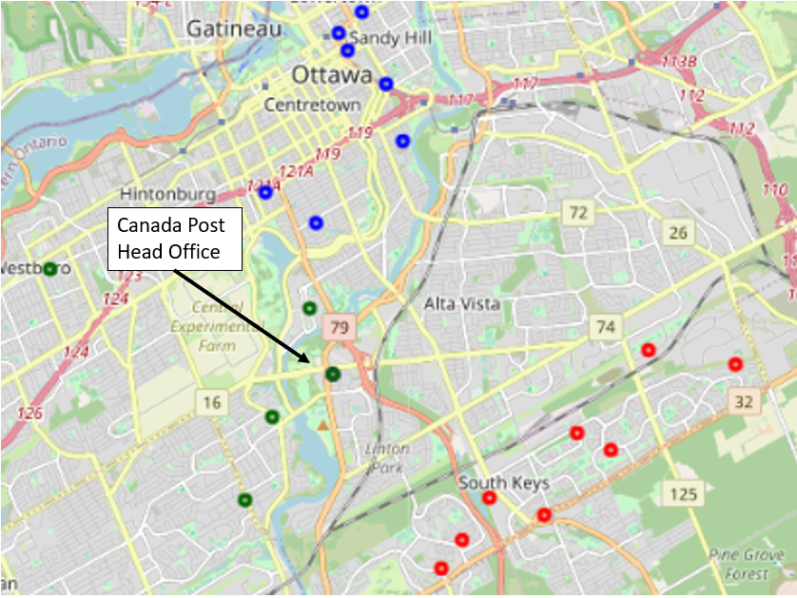
Assignment of Recipients for 3 Delivery Trucks (KMeans Clustering)

Slide 18
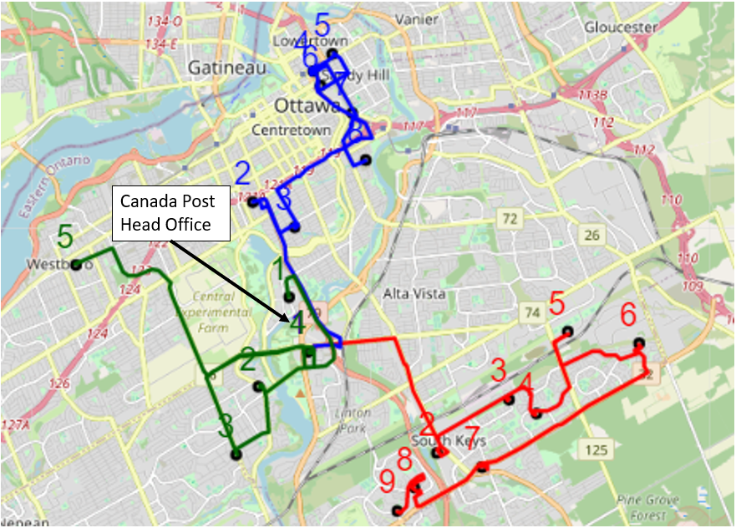
Route Planning & Recipient Sequencing (Metropolis Algorithm)

Slide 19
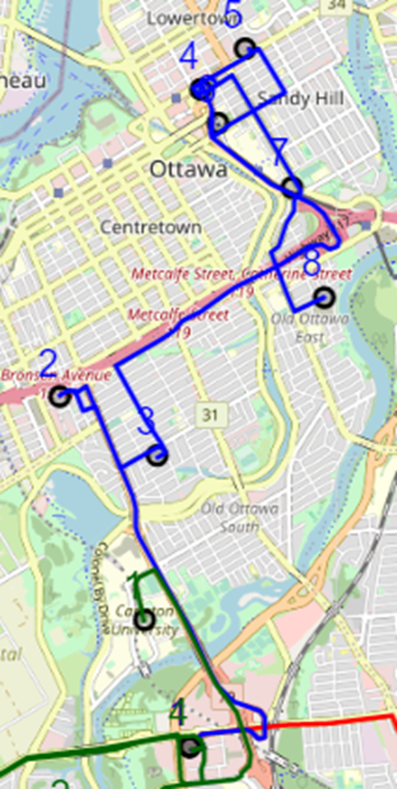
Truck 1 Sequence (Route)
Estimated Travel Time:
56 Minutes

Slide 20
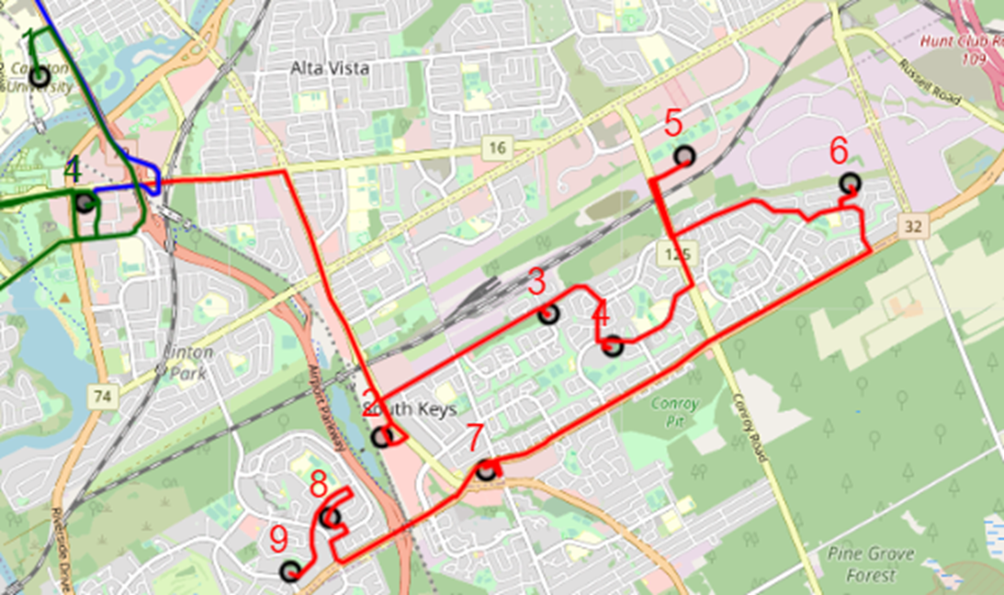
Truck 2 Sequence (Route)
Estimated Travel Time:
57 Minutes

Slide 21
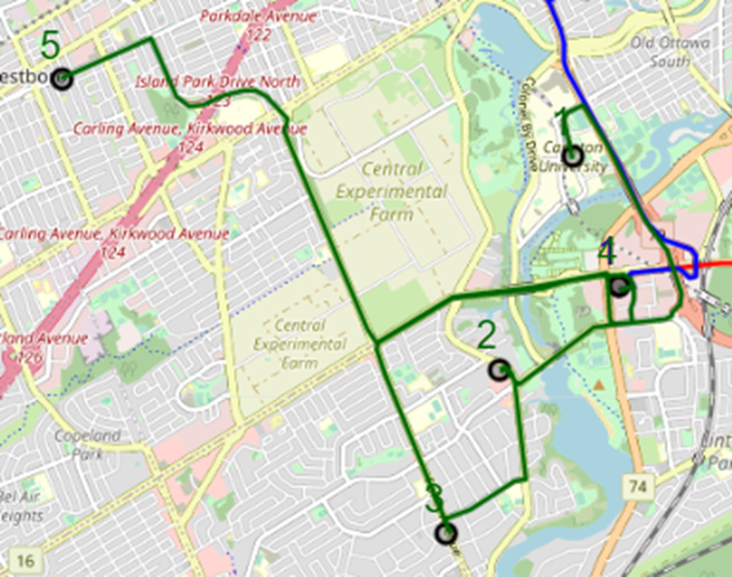
Truck 3 Sequence (Route)
Estimated Travel Time:
44 Minutes

Slide 22
Result Analysis
Overall: How did we do?
Successfully grouped routes for N trucks,
Algorithm converged to shortest routes based on Google maps data,
Visualization showed route sequence and address grouping.

Slide 23
Further Work & Improvements
What’s next, and how can we make it better?
Live updating via re-calculation of route after each delivery,
Tuning algorithm & parameters to improve speed (slow algorithm),
Larger-scale cases,
Quantum annealing → using physical properties to improve speed with DWave!

Slide 24
Thank you for listening!
Any questions?

